Slide 1
Teacher Notes

Slide 3
Symbols
I do: my turn to talk. This is the explanation section of our lesson where you are required to listen.
We do: this is where we discuss or work on the concepts together.
You do: your turn to be involved. You may be working in a group or on an activity individually.

Slide 5
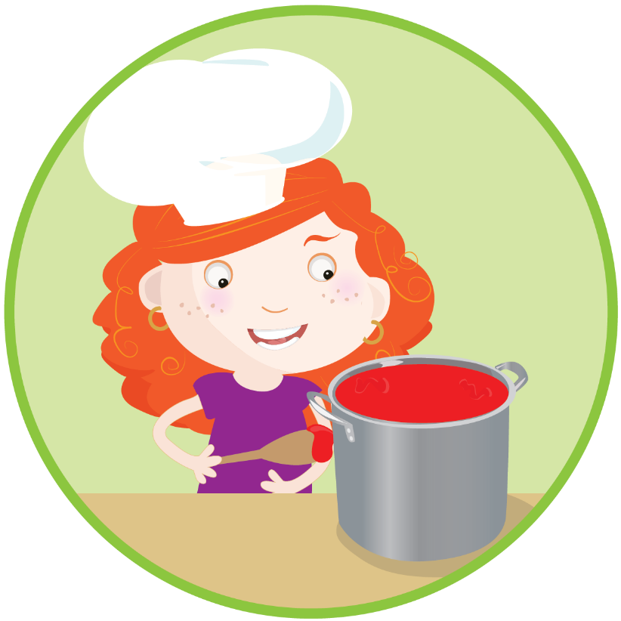
Procedure Text - Overview
Procedure texts inform how to do or make something through a series of steps.
There are many types of procedure texts, such as:
recipes
instructions
directions
rules.

Slide 6
Procedure Text Structure
Title | This is a clear statement about what you are going to do or make.
Materials/Ingredients | This is a list of items that you will need to complete the task.
Method | This is a series of ordered steps explaining how to complete the task.

Slide 7
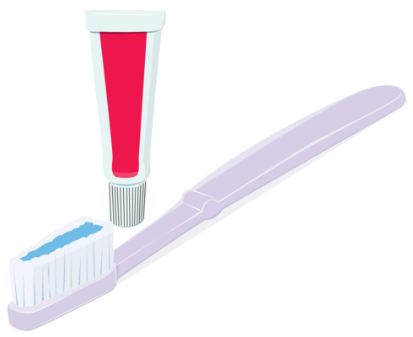
How to Brush Your Teeth
Materials
Toothbrush
Toothpaste
Water
Method
Squeeze some toothpaste on the toothbrush.
Put your toothbrush under some water.
Brush your teeth thoroughly for three minutes.
Rinse your mouth and the toothbrush with water.

Slide 8
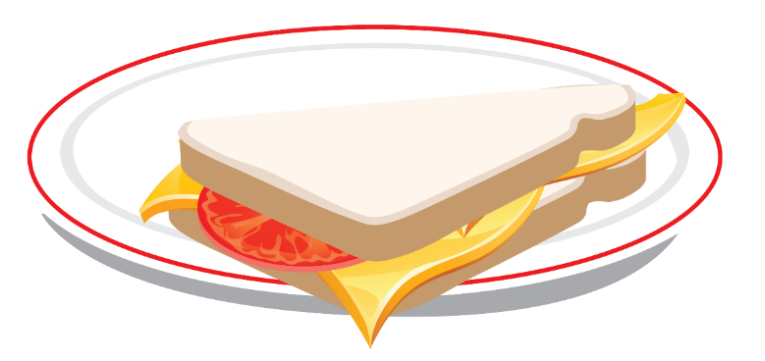
How to Make a Cheese Sandwich
Ingredients
2 slices of bread
1 slice of cheese
Butter
A knife
A chopping board
Method
Lay the slices of bread on the chopping board.
Carefully spread the butter on the slices of bread.
Lay the cheese on top of one of the slices of bread.
Place the other slice of bread on top of the cheese.
Carefully cut the sandwich in half and place it onto a small plate.

Slide 9
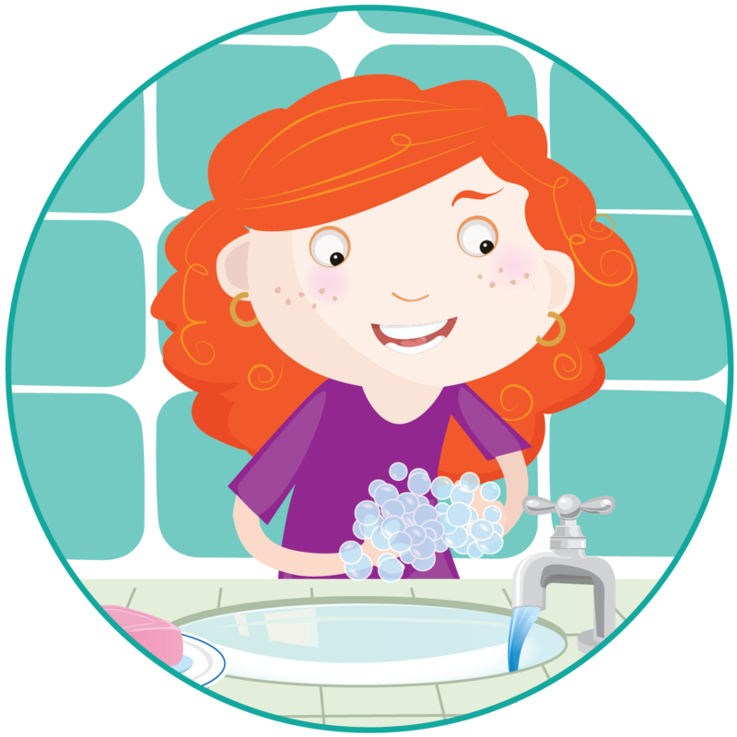
Procedure Text Structure - Class Activity
As a class, work together to unjumble the procedure text, How to Wash Your Hands.
Remember to look for:
the title
the materials
the method.

Slide 10
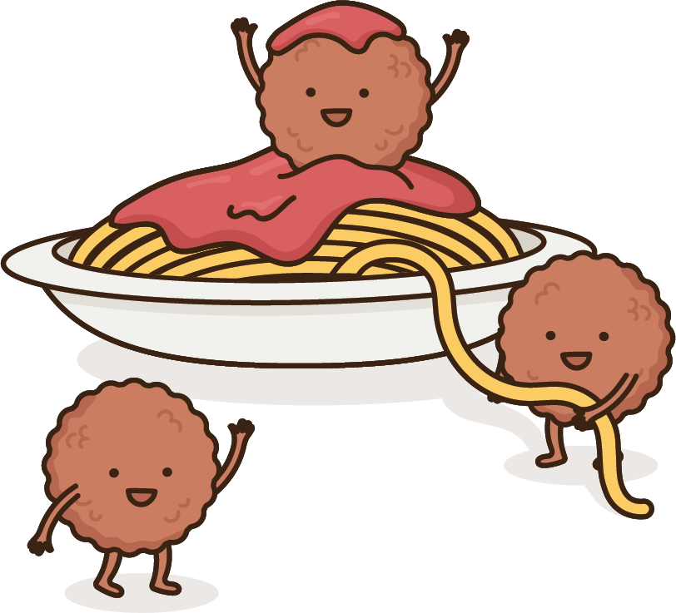
Procedure Structure - Review
Use your knowledge of procedure structure to correctly sequence one of these texts:
How to Make Spaghetti
How to Build a Snowman
How to Play Snakes and Ladders
Once you have finished, check the sequence of your text with a classmate.

Slide 11
Procedure Texts - Language
Procedure texts use clear and direct language. They use words that are related to the topic of the procedure.
Here are some examples of the language you might find in procedure:
common nouns
action verbs
‘ly’ adverbs
adverbial phrases.

Slide 12
Language in Procedure Texts
Common Nouns
A common noun is a person, place or thing.
Action Verbs
An action verb is a doing word.
Adverbs
An adverb describes a verb.
Adverbial Phrase
An adverbial phrase tells when, where or how.

Slide 13
Procedure Text Language - Example
Common Nouns | Squeeze some toothpaste on the toothbrush.
Action Verbs | Put your toothbrush under some water.
Adverbs | Brush your teeth thoroughly for three minutes.
Adverbial Phrase | Rinse your mouth and the toothbrush with water.

Slide 14
Procedure Language - Class Activity
The series of steps below has been taken from a procedure text called How to Build a Snowman.
Work together as a class to identify the action verbs (doing words).
Make a head and a body out of snow. Put the head on the body.
Stick a carrot into the middle of the head for a nose.
Place two pebbles onto the head as eyes.
Add a twig to each side of the body as arms.
Decorate the snowman with a beanie and a scarf.

Slide 15
Procedure Language Activity - Answers
1. Make a head and a body out of snow. Put the head on the body.
2. Stick a carrot into the middle of the head for a nose.
3. Place two pebbles onto the head as eyes.
4. Add a twig to each side of the body as arms.
5. Decorate the snowman with a beanie and a scarf.

Slide 16
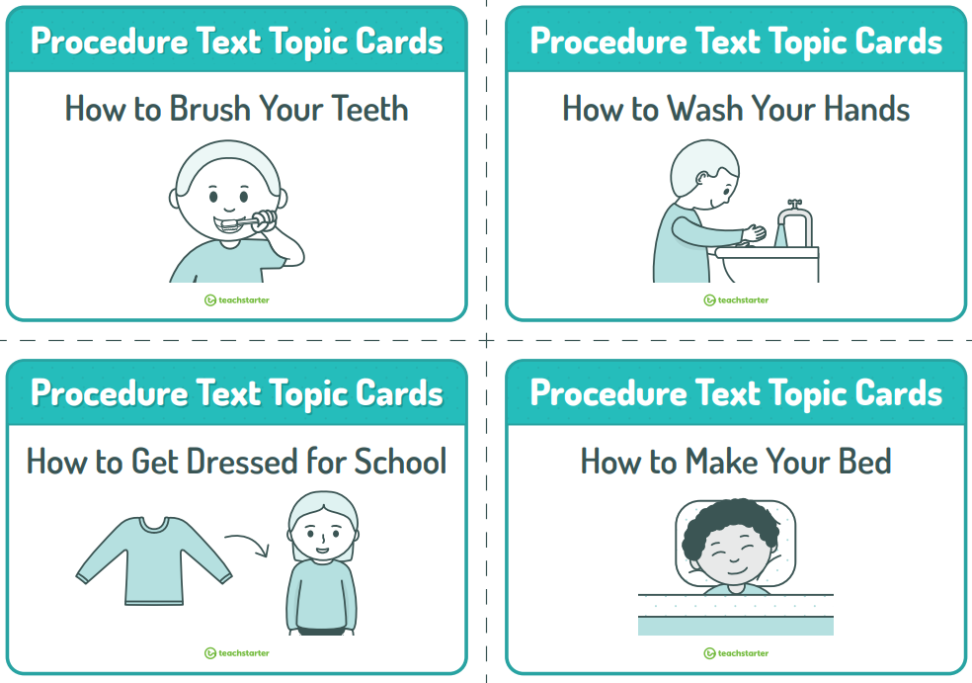
Procedure Language - Review
Choose a topic that interests you from the Procedure Text Topic Cards.
In your workbook, write a list of verbs (doing words) that might be included in a procedure text written on this topic.
If you can, try to write an adverb (a word which describes the verb) to accompany each verb you have listed.

